Slide 1
Aim
To make and interpret a tally chart.
Success Criteria
I can draw a five bar gate tally.
I can count and write the total.
I can gather information using a tally.

Slide 2
Fives
This is a five bar gate tally. We use it to help us to count. It is easy to count large numbers using a tally by counting in fives.
5
4
3
2
1
Click to watch how we make a five bar gate tally.

Slide 3
Fives
How many bananas are there?
There are 35 bananas.

Slide 4
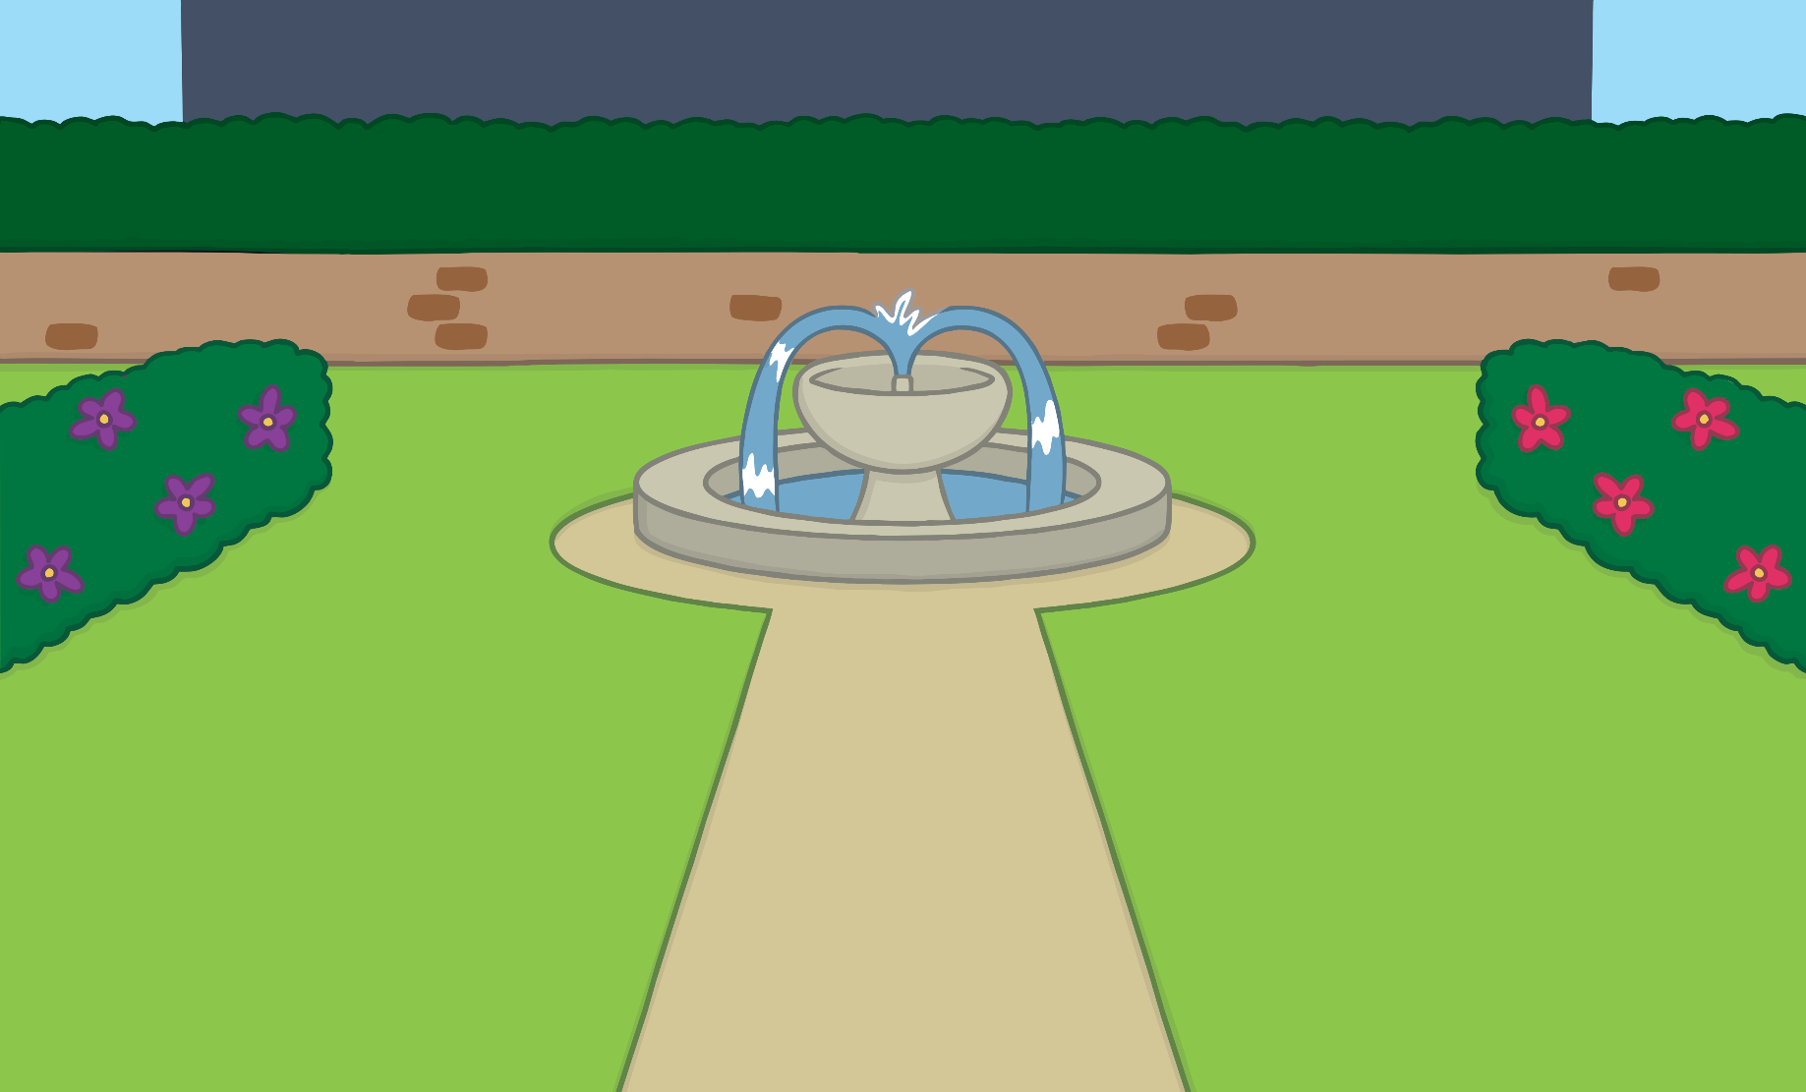
Fives
How many flowers are there?
There are 25 flowers.

Slide 5
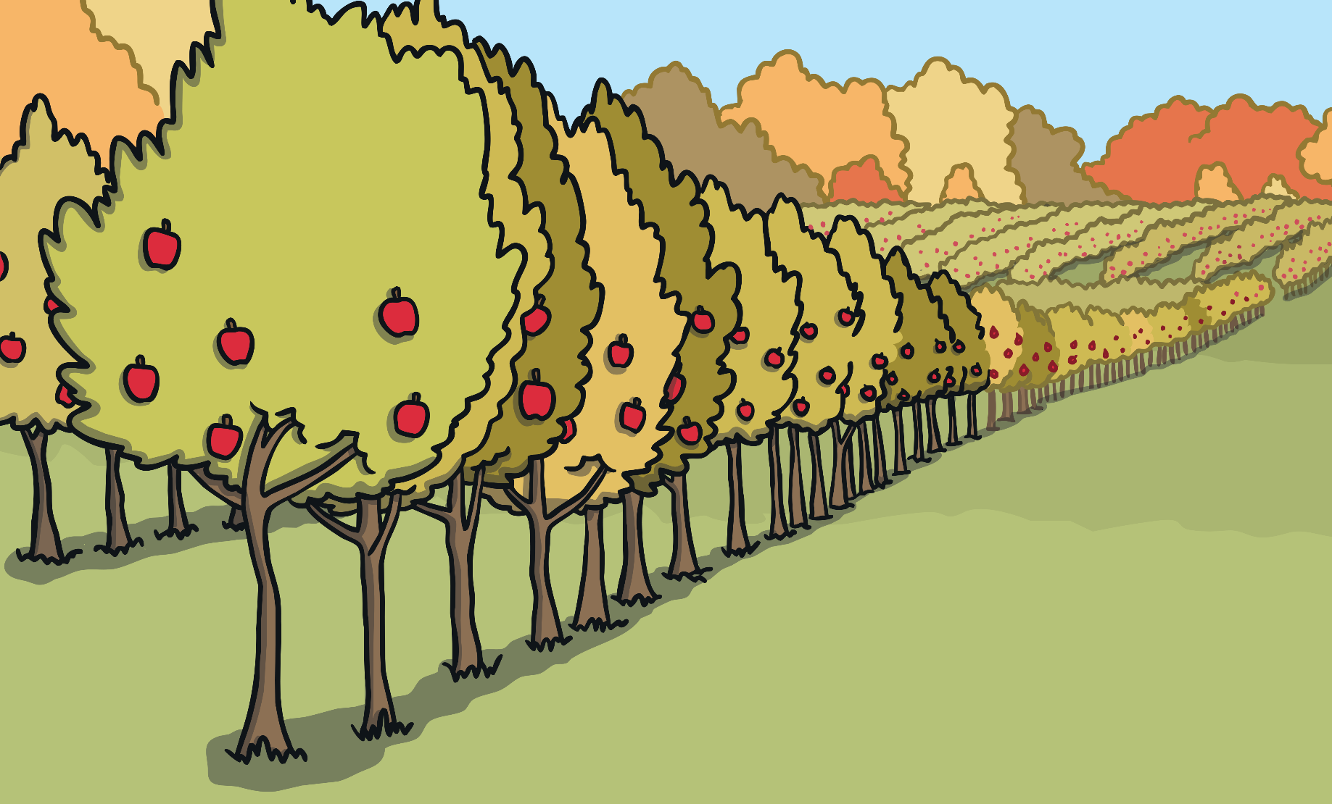
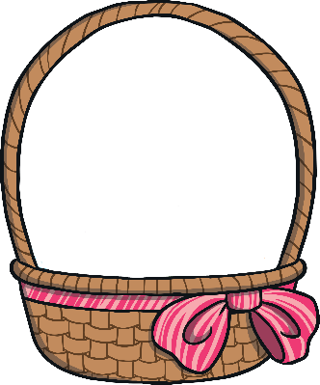
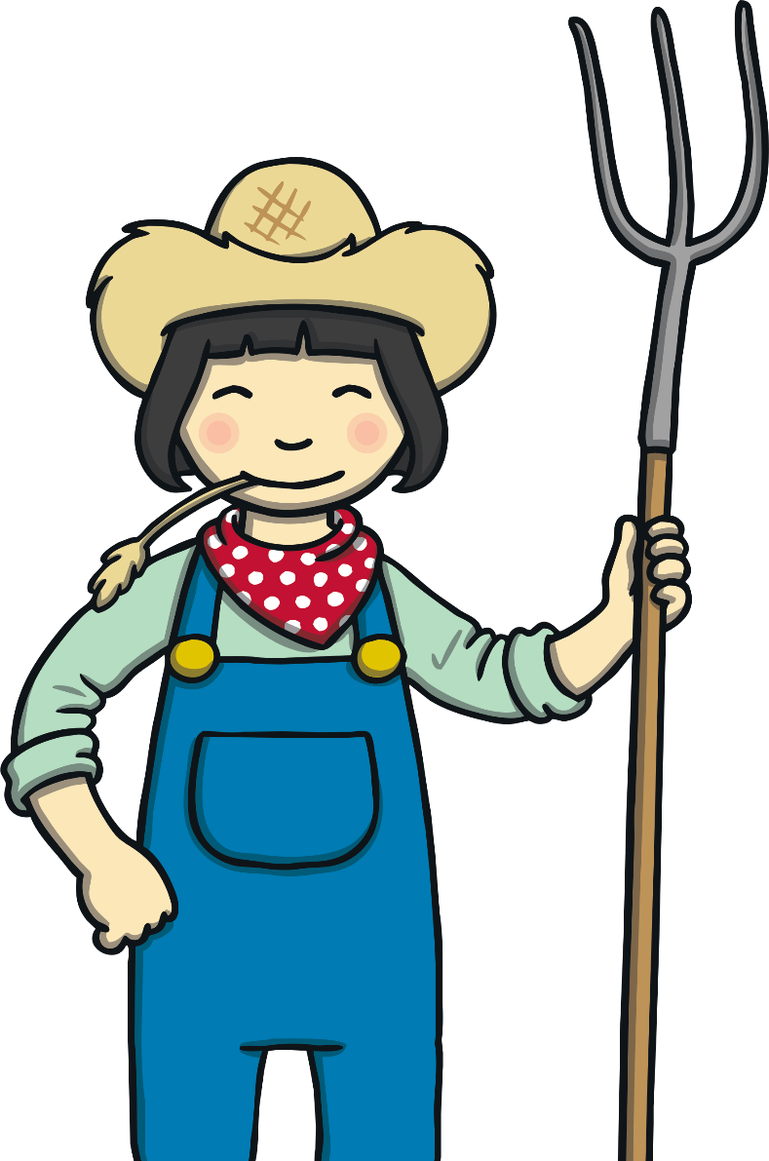
Fives
How many apples are there?
There are 15 apples.

Slide 6
Fives
How much money is there?
There is 30p.

Slide 7
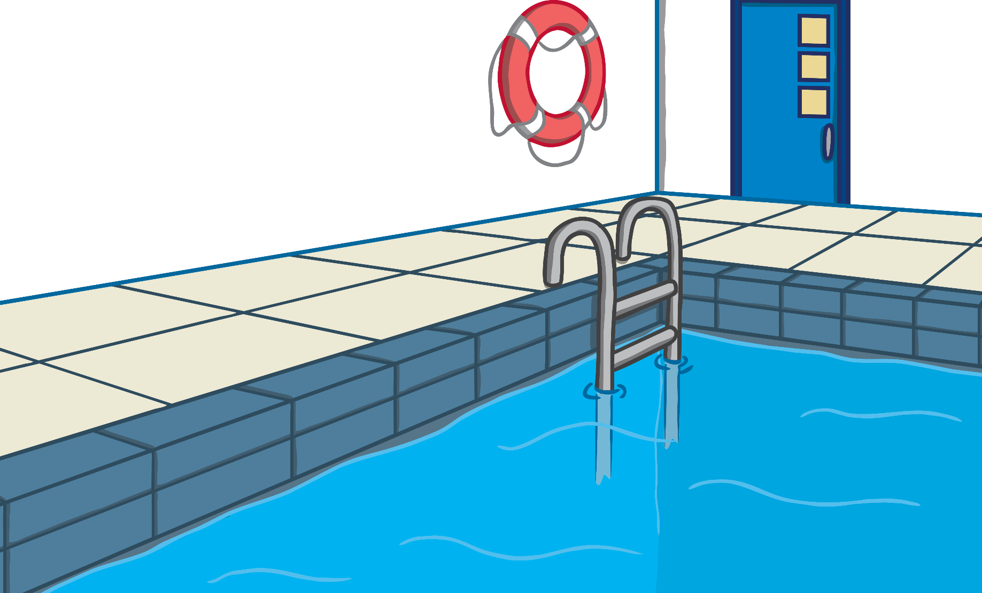
Fives
How many toes are there?
There are 40 toes.

