Slide 1

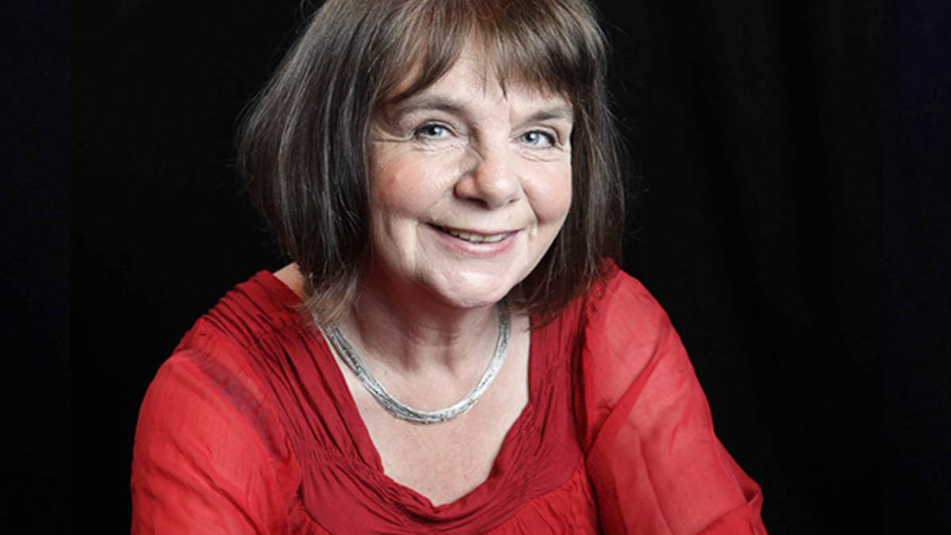
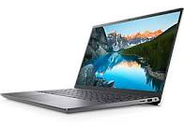
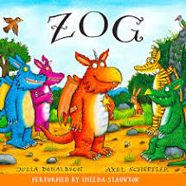
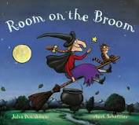
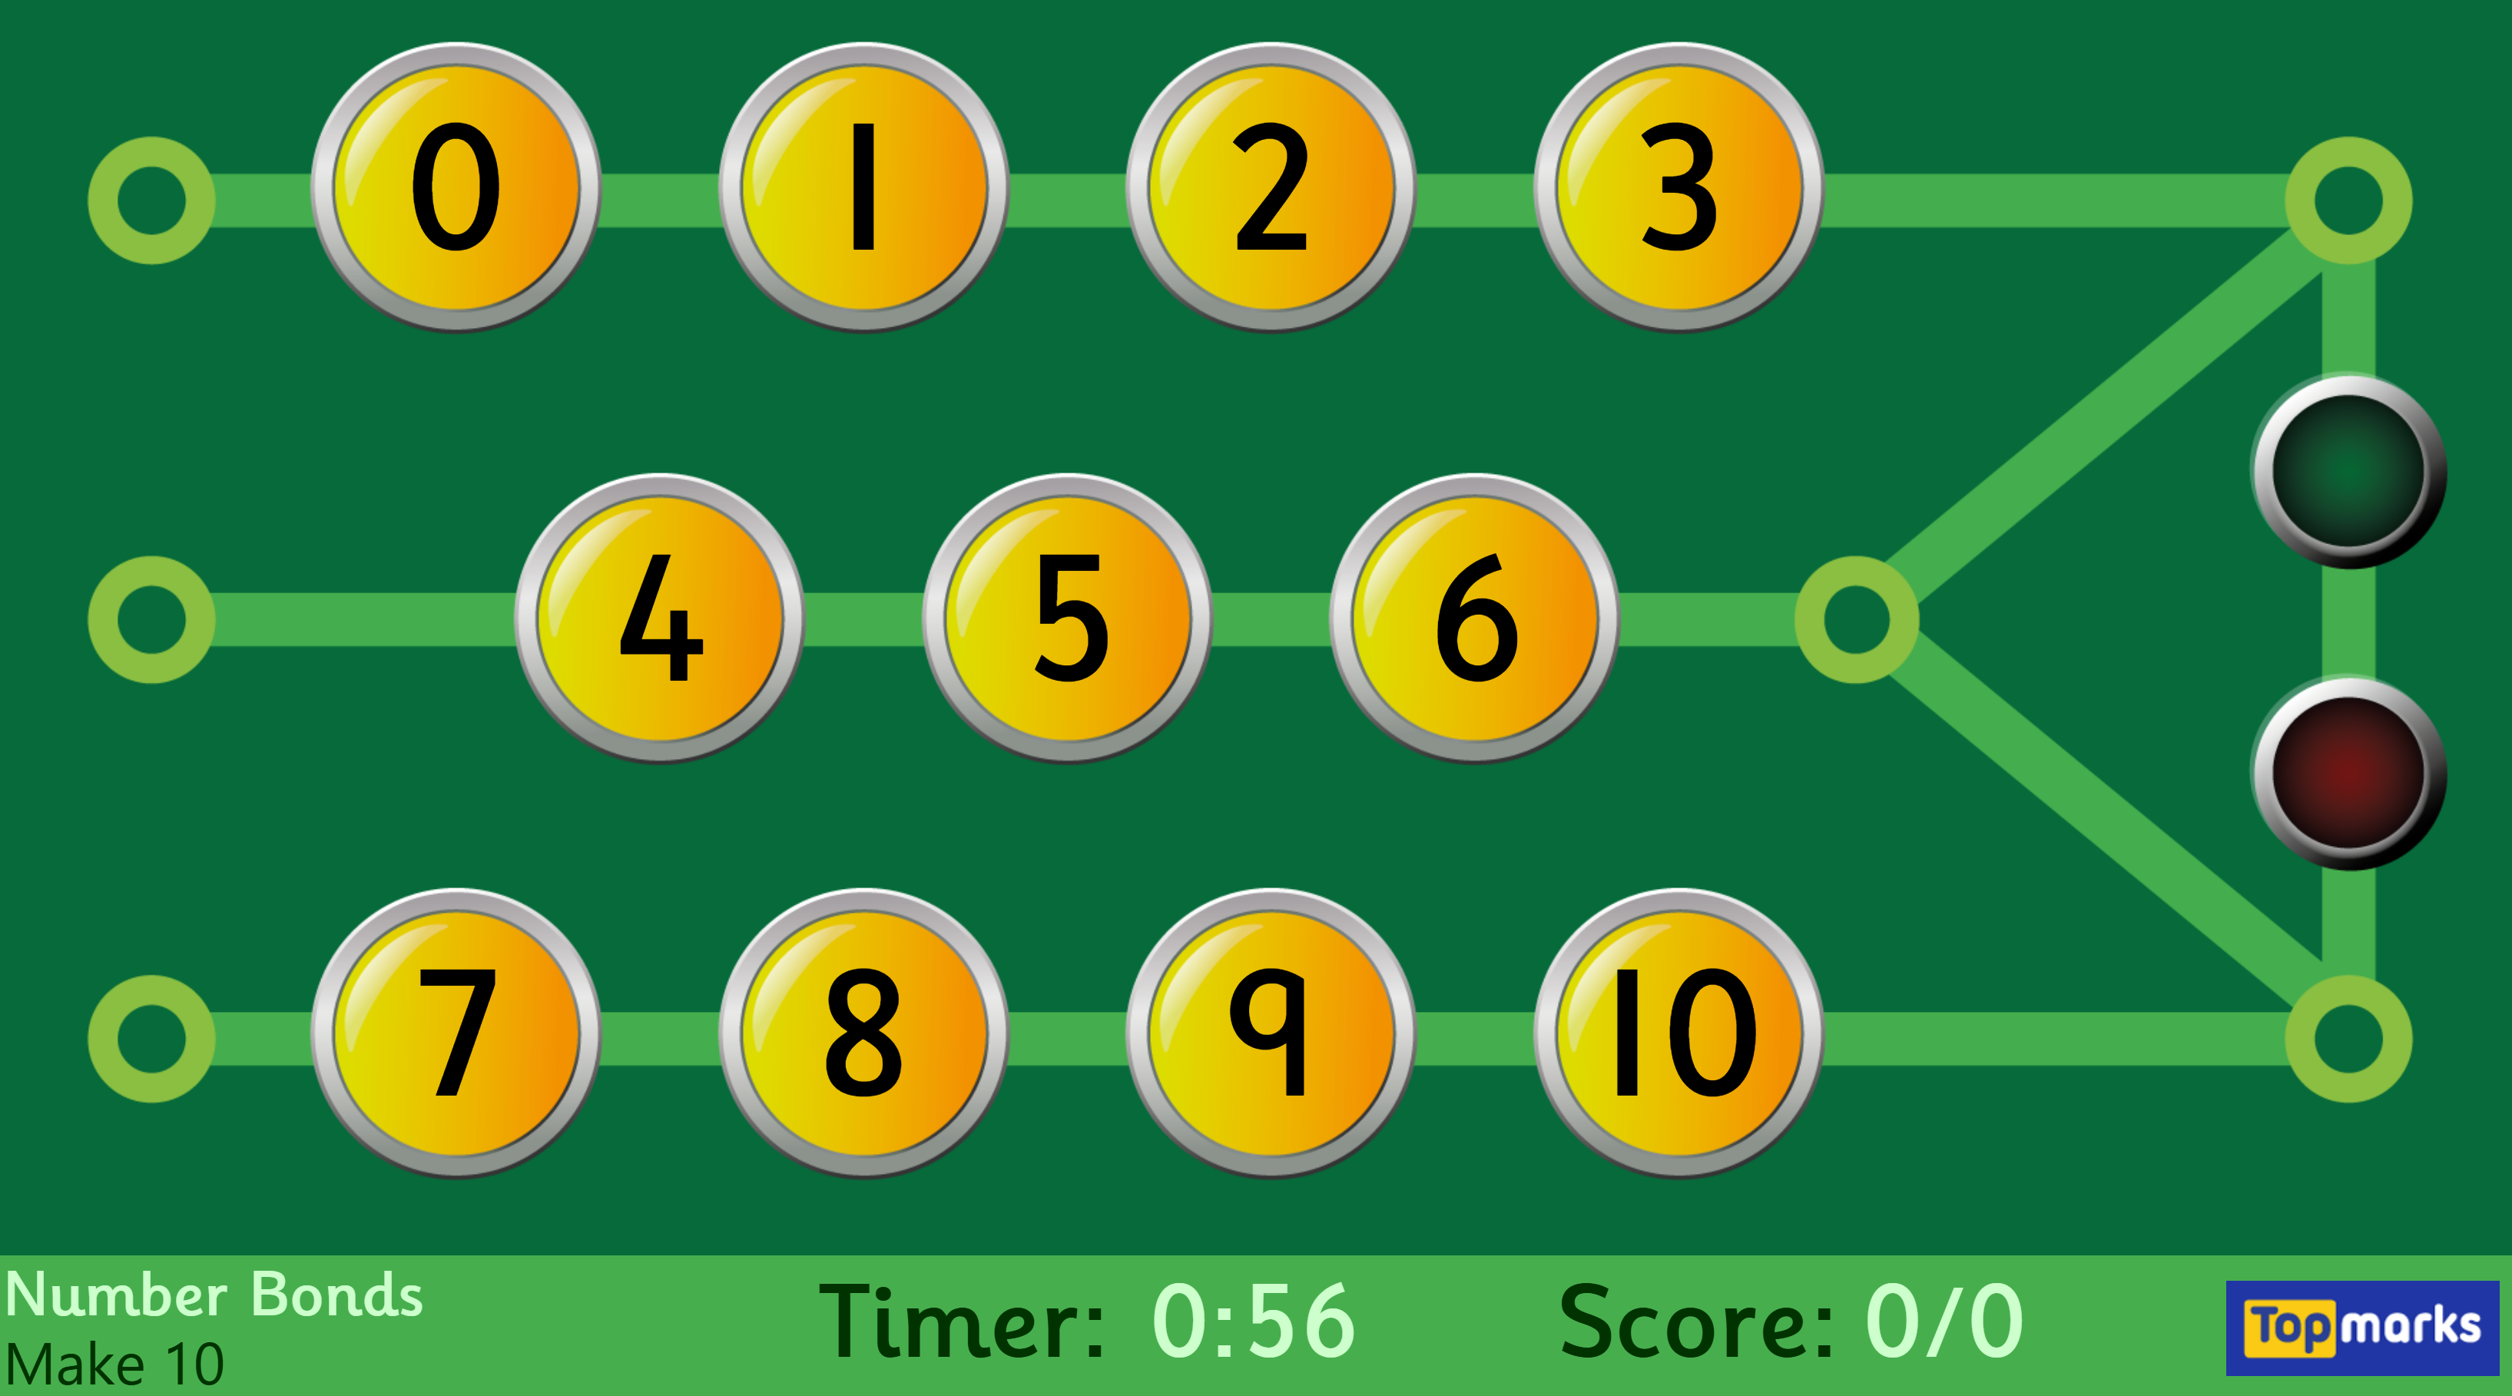
Autumn 1 – The Wonderful World of Julia Donaldson
Year 1 Optional home learning
This is a takeaway menu of home learning for you and your child to choose from should you wish to complete any learning activities together at home. Please share anything that you do complete with us via your child’s Tapestry account.
We look forward to seeing what you have been up to.
Use a computer or tablet to find out facts about the author Julia Donaldson. Write your facts down and take a photo so that we can share them in class. | Create a picture of The Gruffalo using whatever art materials you have at home. For example, this could be naturally found resources such as leaves, twigs and stones, or paint, crayons, felt tip pens or collage materials. You could also make a model of The Gruffalo from playdough or junk. | Share your favourite Julia Donaldson book with your family. Why is it your favourite? Draw a picture of your favourite character and label it if you can.
Pratise quick recall of our number bond to 10 using this online game with an adult https://www.topmarks.co.uk/maths-games/hit-the-button | Go on a walk in your garden, nearby park or local area and collect different types of leaves. Compare and talk about the different leaves that you find with a grownup. Do you know the names of the trees that the leaves come from? Can you find out the names of the trees that you don’t know? | Make a set of number cards 0-10. Then try the following activities: Order the cards from smallest to largest and largest to smallest. Find 1 more/less than a number. Count on and backwards from any number. Take a handful of objects and practise counting them accurately.
Please read as often as possible with your child and learn your common exception words for Year One which are available in a list on Tapestry.

